Slide 1
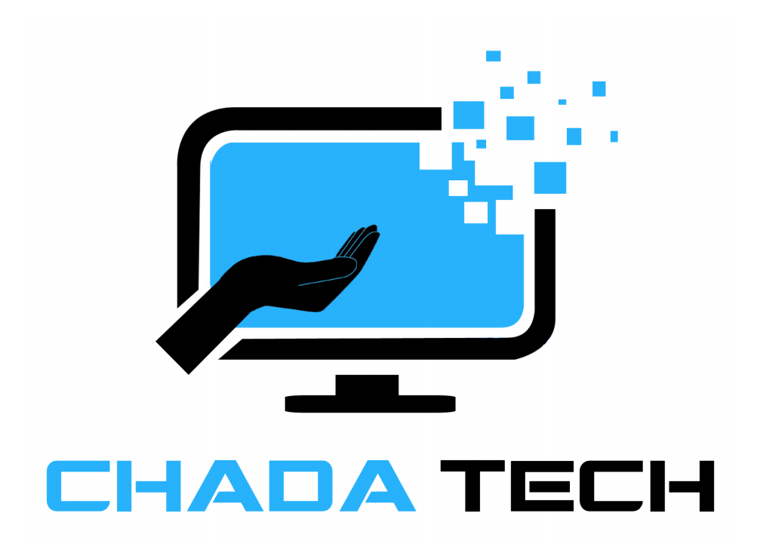
Agile Presentation
By:
Darrell Walker
Brought to you by
SNHU Travel

Slide 2

Explaining Agile Roles
Scrum Master: Facilitates daily stand-ups, Sprint Planning, and removes impediments. Ensures team alignment and task distribution.
Product Owner: Prioritizes backlog based on client feedback and market trends. Clarifies user stories and acceptance criteria.
Development Team: Collaborates to design, code, and test features iteratively. Engages in peer reviews to maintain code quality.
Photo by Kelly Sikkema on Unsplash

Slide 3
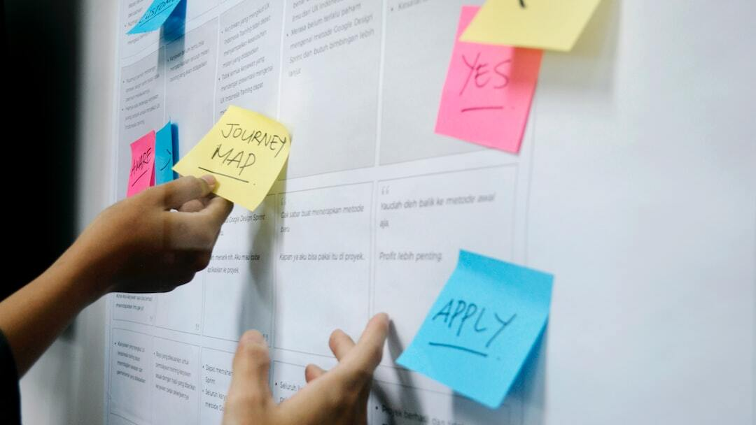
Explaining Agile Phases
Initiation: Identify project vision, objectives, and stakeholders.
Planning: Create a product backlog, define user stories, and plan Sprints.
Execution: Develop and test features iteratively in Sprints, with regular reviews and adjustments.
Closure: Release the final product, gather feedback, and conduct Sprint Retrospectives to improve future processes.
Photo by UX Indonesia on Unsplash

Slide 4

Waterfall vs Agile Development
Waterfall: Linear and sequential approach. Each phase must be completed before the next begins. Less flexibility to changes once a phase is completed.
Agile: Iterative and incremental approach. Allows for continuous feedback and adaptation. More flexible to changes throughout the project lifecycle.
Photo by Nicolas J Leclercq on Unsplash

Slide 5

Factors to Consider: Waterfall vs Agile
Project Complexity: Agile is better for complex, evolving projects with uncertain requirements. Waterfall suits simple, well-defined projects.
Stakeholder Involvement: Agile requires continuous stakeholder engagement. Waterfall has minimal stakeholder involvement after requirements are defined.
Flexibility and Adaptation: Agile allows for changes throughout the development process. Waterfall is rigid, with changes being difficult to implement once a phase is completed.
Delivery Speed: Agile delivers incremental value quickly and regularly. Waterfall delivers the final product at the end of the project lifecycle.
Photo by WeRoad on Unsplash

Slide 6

References
Jile (2023): 7 Key Benefits of Using the Agile Scrum Methodology. Retrieved from https://www.jile.io/blog/7-key-benefits-of-using-the-agile-scrum-methodology
StarAgile (2023): Unlocking the 10 Benefits of Scrum and How to Achieve Them. Retrieved from https://staragile.com/blog/benefits-of-scrum
Business News Daily (2023): What Is Agile Scrum Methodology? Retrieved from https://www.businessnewsdaily.com/what-is-agile-scrum-methodology
Workamajig (2023): 6 Key Scrum Benefits in Project Management. Retrieved from https://www.workamajig.com/blog/scrum-benefits-project-management
Photo by Aaron Burden on Unsplash

